Slide 1
Improving Developer Support with a Scalable GCP-Powered Chatbot

Slide 2

Current issues
Current approach uses a manual ticket for resolving issues. This method works but incurs in high costs and inefficiencies due to:
Requiring 24/7 availability
Need for accurate, source-specific answers.
Requires flexible workforce during peak hours

Slide 3

Proposed Solution
As a solution, we propose Dockie, a generative AI chatbot that is capable of automating responses to common developer queries.
Available 24/7
Utilizes Dialogflow CX for conversational AI.
Provides source-based answers by linking to internal documentation.
Dockie

Slide 4
Choosing the Correct Approach
Evaluated other possible approaches for implementing the chatbot, such as:
Custom Chatbot with Pinecone:
Use a vector database (using Pinecone) to build a conversational AI model from scratch.
Would require to do embedding of documents into vector space and using a large language model (e.g., OpenAI, Cohere) for generating responses.
Key considerations:
Cost (Pinecone pricing versus GCP free-tier).
Complexity of building versus leveraging existing tools.
Time constraints for project delivery.

Slide 5
Choosing the Correct Approach
CHOSE GCP DIALOGFLOW CX BECAUSE:
It provided a frictionless integration with the existing GCP ecosystem.
Knowledge bases were natively supported without needing vector embedding or additional APIs.
Offered built-in conversational flow management, reducing development complexity.
Allowed for easy integration of the chatbot within the Docker Webpage.

Slide 6


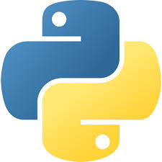
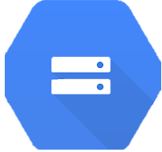



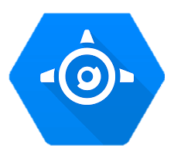
Architecture Overview
Processing
Storage
Chatbot Creation
Webpage Hosting

Slide 7
Challenges Faced - Parsing and Formatting Data
Challenge: The documentation provided was in markdown (.md) format, and it had to be converted into structured data (JSONL) for use in the Dialogflow knowledge base.
Solution:
Wrote a Python script to process the .md files, extracting metadata and converting them into the required metadata.jsonl format.
The metadata contains information about the document title, and location within the GCP storage
Debugged edge cases like incomplete metadata and JSONL structure inconsistencies.

Slide 8
Challenges Faced - Handling GCP Integration
Challenge: Uploading the files to the Vertex AI data store proved troublesome until the correct .JSONL format was found. Setting up and managing various Google Cloud services (Cloud Storage, Dialogflow CX, App Engine) as well as their IAM requirements.
Solution:
Used gcloud CLI to create the necessary resources (App Engine).
Researched and implemented the correct IAM permissions for accessing knowledge bases and exporting configurations.
Used documentation examples as base cases for the necessary JSONL format and adapted the Python script.

Slide 9
Demo
GitHub Pages: https://dockerchat.github.io/DockerChat/
Google App Engine: https://genuine-sector-443820-b5.uc.r.appspot.com/
Dockie

Slide 10
Results and Benefits
Efficiency Gains:
Faster ticket resolution for common developer issues.
24/7 availability reduces manual workload.
Enhanced User Experience:
Source-based responses improve trust and clarity.
Low latency responses due to multiple people getting answers simultaneously
Scalability:
Easy addition of new knowledge bases.
Fast implementation in multiple environments

Slide 11
Costs
Dialogflow CX | Google Cloud Storage | Google App Engine (Optional for Hosting the Frontend)
Free Tier: 1,000 sessions per month are free for Standard Edition. Costs Beyond Free Tier: $20 per 100 sessions for Standard Edition. A "session" is defined as a single interaction between the user and the agent (e.g., user query and chatbot response) | Free Tier: 5 GB of standard storage per month. 50,000 Class A operations (e.g., uploads) per month. 1,000,000 Class B operations (e.g., reads) per month. Costs Beyond Free Tier: $0.026 per GB per month for storage. | Free Tier: 28 instance hours per day for the standard environment. 1 GB of egress traffic per day. Costs Beyond Free Tier: $0.05 per instance hour. $0.12 per GB for outgoing traffic.

Slide 12
Costs Estimation
Service | Estimated Cost
Dialogflow CX | $40 (2,000 sessions at $20 per 100 sessions).
Cloud Storage | $0.52 (5 GB free, 5 GB at $0.026/GB) + $0.50 (extra operations) = $1.02.
App Engine | $1.10 (22 extra instance hours) + $0.12 (1 GB outgoing traffic) = $1.22.
Total | $42.24 per month
Dialogflow CX: 3,000 sessions per month (2,000 free).
Cloud Storage: 10 GB of stored data and 100,000 operations.
App Engine: 50 instance hours and 2 GB of outgoing traffic.

